Slide 1
Data Exploration with Synapse and KQL
Kevin Feasel
CTO, Faregame Inc

Slide 2
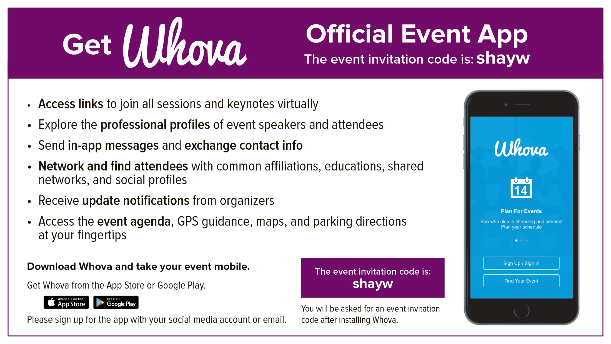
M365: M365Spring22
Dev/Azure AI/SQL: DEVSpring22m
DEVSpring22
DEVSpring22

Slide 3
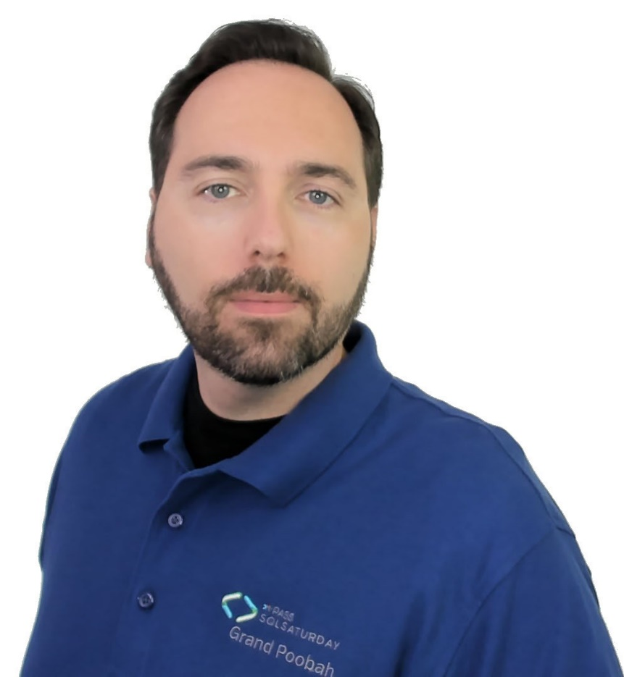
Who am I? What am I doing here?
Data & AI Partner @ Solliance
CTO @ Faregame Inc
Curated SQL @ https://curatedsql.com

Slide 4
Motivation
Introduce Azure Synapse Data Explorer
Explain why Data Explorer makes sense in a warehouse
Introduce KQL
Perform time series analysis with KQL
Recommendations on writing queries

Slide 5
Agenda
What is Azure Synapse Data Explorer?
Loading Data
Querying Data – KQL
Fun with KQL
Query Recommendations

Slide 6
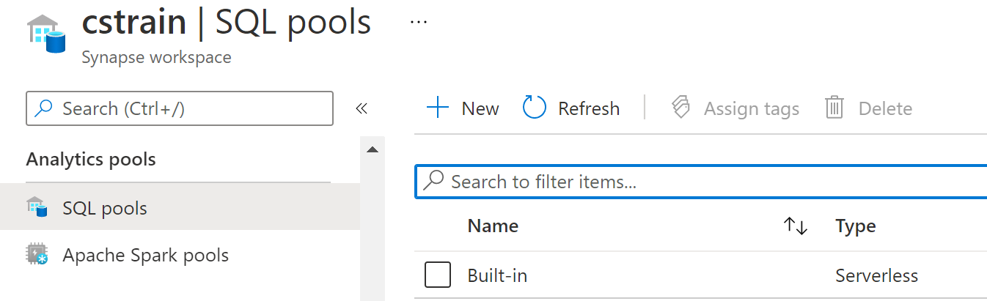
Azure Synapse Analytics
Azure Synapse Analytics is Microsoft's platform for modern data warehousing. It is made up of four components:
Dedicated SQL pools
Spark pools
Serverless SQL pool
Data Explorer pools

Slide 7
Dedicated SQL pools
Azure Synapse Analytics dedicated SQL pools, nee Azure SQL Data Warehouse, offer up a Massive Parallel Processing approach to data warehousing and work best in classic data warehousing scenarios:
You are using the Kimball model of facts and dimensions.
Your total data size is at least 1 TB.
Your major fact tables have at least 1 billion rows of date and numeric data.
Your major dimension tables are relatively small but wide.
Users typically work off of a set number of queries.

Slide 8
Spark pools
Azure Synapse Analytics Spark pools allow you to spin up Apache Spark clusters. Key use cases for these Spark clusters include:
Complicated data transformation projects, such as working with regular expressions.
Distributed machine learning tasks not suited for Azure Machine Learning.
Migrating work from on-premises Apache spark clusters or HDInsight clusters.

Slide 9
Serverless SQL pool
The serverless SQL pool is a bit different from a dedicated SQL pool in the following ways:
Serverless SQL pools do not store data. They read files directly from your data lake and expose them as SQL tables.
The serverless SQL pool requires no infrastructure or resource reservation and has no up-front costs.
The pricing model for the serverless SQL pool is based on data utilization: approximately $5 per terabyte of data processed.

Slide 10
Data Explorer pools
Data Explorer pools allow you to perform real-time analysis on large volumes of data. The initial use case of this was to process log data, but using the Kusto Query Language (KQL), we can also perform detailed time series analysis, whether real-time or off of already-stored data.

Slide 11
Pricing Data Explorer pools
Azure Synapse Analytics pools typically price on two things: compute and storage. For Data Explorer pools:
Compute based on vCore-hours
Storage based on TB stored per month
Ex: $0.219 per vCore-hour, $23.04 TB/month, 8 vCores & 50 TB on one instance:
$0.219 * 8 * 720 ~= $1261
$23.04 * 50 = $1152
Total: $2413 per month

Slide 12
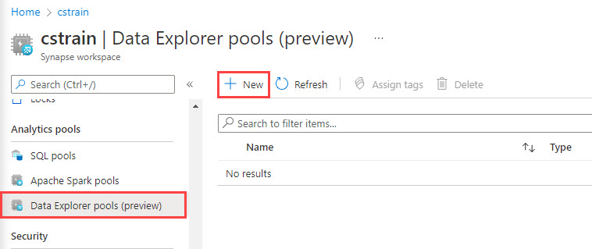
Setup and Configuration
Pre-requisite: you’ve created a Synapse workspace
Create a new Data Explorer pool

Slide 13
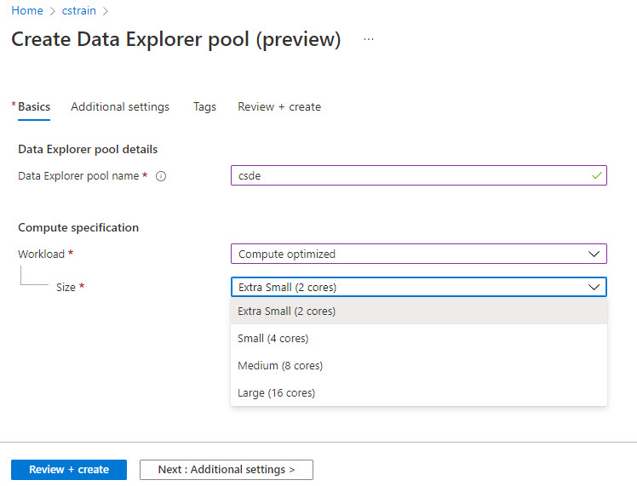
Name and Workload

Slide 14
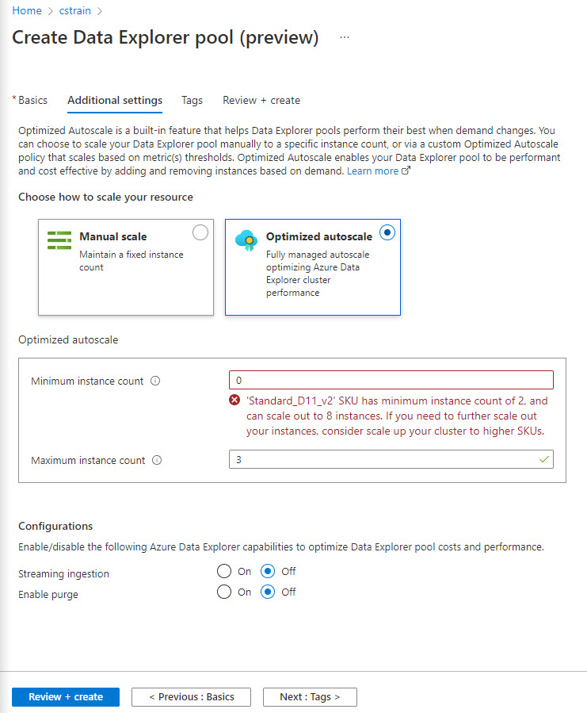
Scaling and Instances

Slide 15
Agenda
What is Azure Synapse Data Explorer?
Loading Data
Querying Data – KQL
Fun with KQL
Query Recommendations

Slide 16
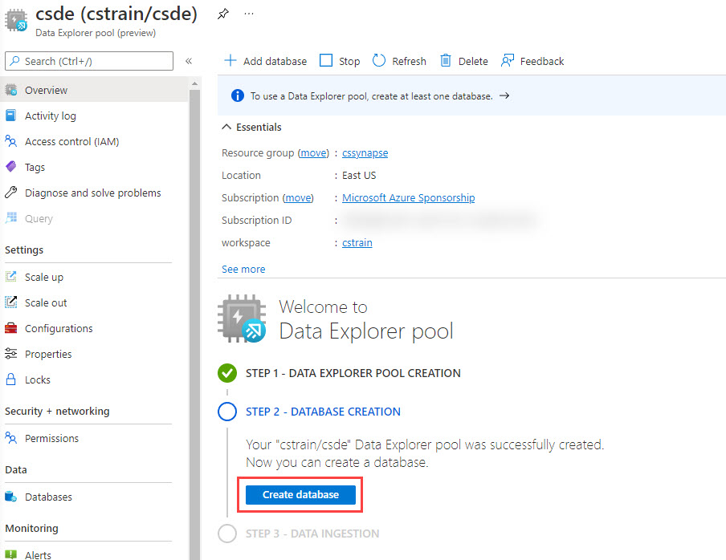
Get a Database

Slide 17
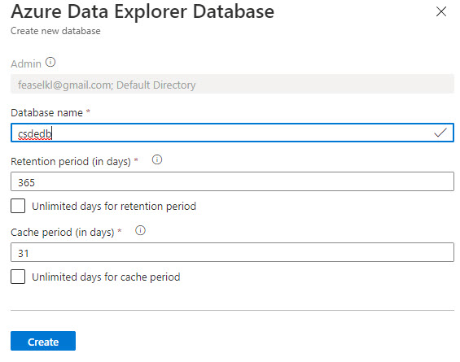
What Makes a Database?

Slide 18
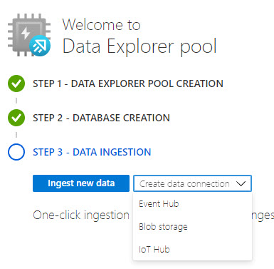
Ingesting Data

Slide 19
DEMO TIME

Slide 20
Review: Data Formats
Various text formats: CSV, SCSV (semi-colon), TSV (tab), TXT (non-structured text)
JSON
Avro
Parquet
ORC

Slide 21
Review: Streaming Ingestion
Event Hub
Event Grid
IoT Hub

Slide 22
Review: Batch Ingestion
Bulk load from data lake
Preferred method
Maximum value in a batch: 5 minutes, 1000 items, 1 GB of data

Slide 23
Agenda
What is Azure Synapse Data Explorer?
Loading Data
Querying Data – KQL
Fun with KQL
Query Recommendations

Slide 24
Kusto Query Language (KQL)
Language for log exploration—similar to Splunk’s query language
Kinda-sorta not really like SQL
Case-sensitive!

Slide 25
Pipes
MyTableName | where EventTypeID == 14
AND DurationMS > 100
| project EventType, DurationMS, NumEvents
| top 10 by DurationMS desc

Slide 26
It’s Not Just for Logs!
Language for log exploration—similar to Splunk’s query language
Kinda-sorta not really like SQL
Case-sensitive!
MORE THAN

Slide 27

Our Demo
Wake County, North Carolina food service inspections

Slide 28
Our Demo
County inspectors visit restaurants, food trucks, school cafeterias, and more and score facility cleanliness
Score technically ranges from 0-100
Data we collect:
Date and time of inspection
Inspector
Location inspected
Overall score
Details on inspection deficiencies

Slide 29
DEMO TIME

Slide 30
Agenda
What is Azure Synapse Data Explorer?
Loading Data
Querying Data – KQL
Fun with KQL
Query Recommendations

Slide 31
Fun with KQL
Time series analysis
Machine learning
Power BI integration

Slide 32
DEMO TIME – Time Series

Slide 33
DEMO TIME – Power BI

Slide 34
Agenda
What is Azure Synapse Data Explorer?
Loading Data
Querying Data – KQL
Fun with KQL
Query Recommendations

Slide 35
Performance Tips and Tricks
Microsoft guidance
Filters first, especially time: filter placement matters!
Use case-sensitive operators
Search in specific columns, not across all columns
Materialize results of complex calculations using materialize()
Remember take 10 (equivalent of TOP 10)

Slide 36
Query Limitations
Microsoft guidance on query limits
No more than 10 concurrent requests per vCore
No more than 500,000 records or 64MB of data returned to client
Can be disabled with set notruncation;
Can be modified with truncationmaxsize; and truncationmaxrecords;
Max memory consumption per operator—prevents runaway queries
Defaults to 5GB
Server timeout configurable

Slide 37
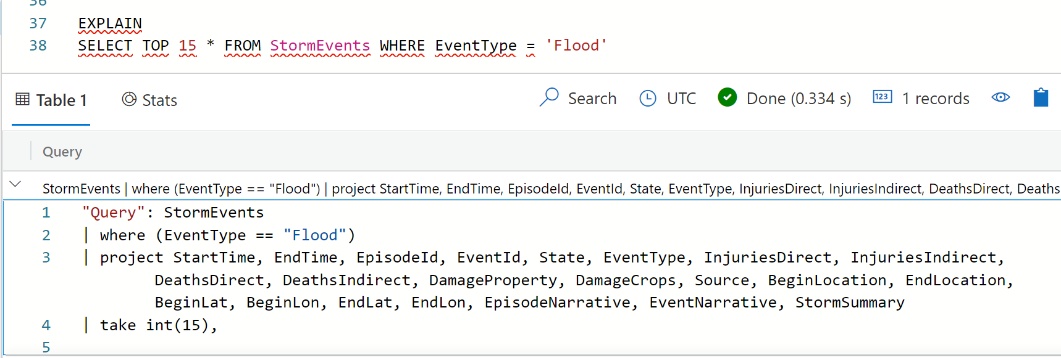
EXPLAIN
SQL to Kusto query cheat sheet
ONLY supported in Azure Data Explorer right now

Slide 38
DEMO TIME – EXPLAIN

Slide 39
Wrapping Up
To learn more, go here:
https://csmore.info/on/synapsekql
And for help, contact me:
feaselkl@solliance.net
@feaselkl

Slide 40
Don’t forget to complete an online evaluation
Data Exploration with Synapse and KQL
Your evaluation helps organizers build better conferences and helps speakers improve their sessions.
Thank you!

Slide 41
FOR INFORMATION ABOUT OUR NEXT IN PERSON EVENT, VISIT OUR WEBSITE AT

